Slide 1

Algebra 1
Unit 7, Lesson 3 Factoring a Trinomial With a Leading Coefficient of 1 Volume 1, pg. 369

Slide 2


Benchmark
MA.912.AR.1.7
Rewrite a polynomial expression as a product of polynomials over the real number system.
volume 1, pg. 369

Slide 3
Integrated Mathematical Thinking and Reasoning Standards
MA.K12.MTR.2.1 Demonstrate understanding by representing problems in multiple ways.
MA.K12.MTR.3.1 Complete tasks with mathematical fluency.
MA.K12.MTR.4.1 Engage in discussions that reflect on the mathematical thinking of self and others.
MA.K12.MTR.5.1 Use patterns and structure to help understand and connect mathematical concepts.
volume 1, pg. 369

Slide 4

Learning Target
I can factor a trinomial with a leading coefficient of 1.
volume 1, pg. 369

Slide 5

Warm-Up
volume 1, pg. 370

Slide 6
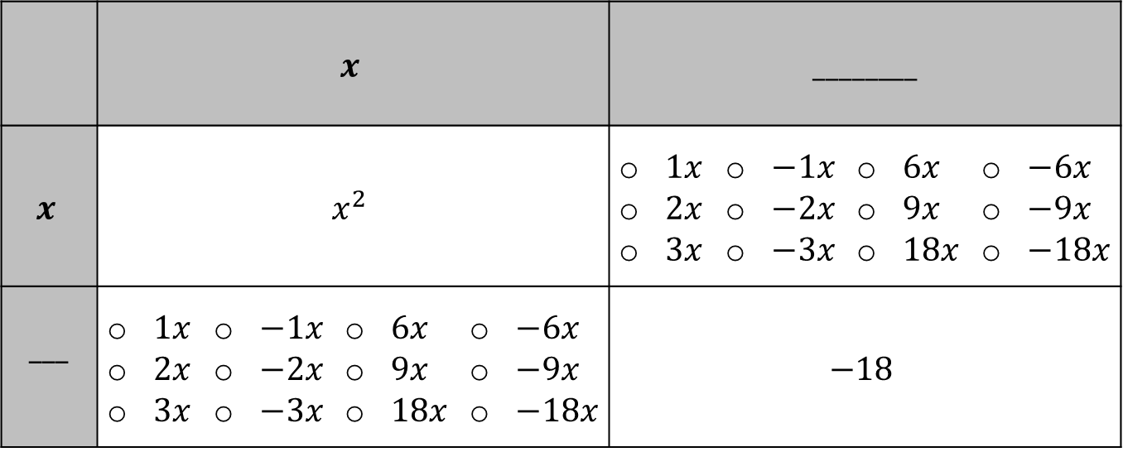
7.3.1 Warm-Up: Bell Work
Complete the table for $x^{2}+3x−18$.
 | $$x$$ |  |  |  | ________
$$x$$ | $$x^{2}$$ |  |  |  | $1x$ $2x$ $3x$ | $−1x$ $−2x$ $−3x$ | $6x$ $9x$ $18x$ | $−6x$ $−9x$ $−18x$
___ | $1x$ $2x$ $3x$ | $−1x$ $−2x$ $−3x$ | $6x$ $9x$ $18x$ | $−6x$ $−9x$ $−18x$ | $$−18$$
volume 1, pg. 370

Slide 7

Collaboration
volume 1, pg. 370

Slide 8

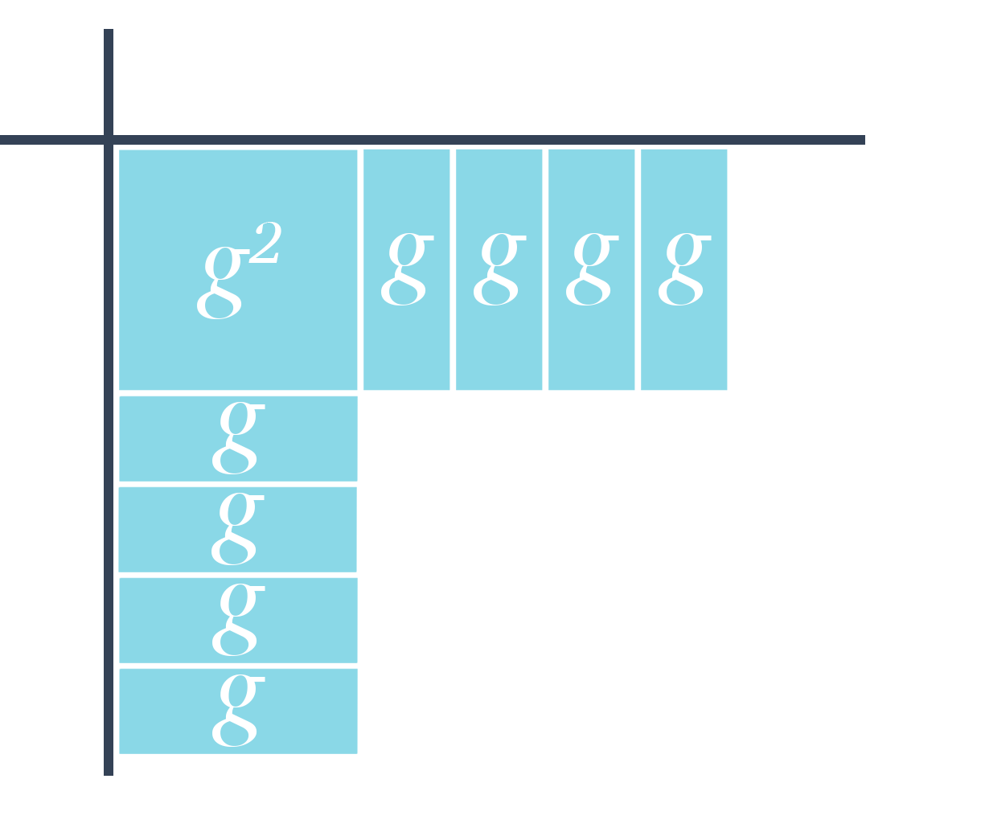
7.3.2 Collaboration: Different Methods of Factoring
Garcelle is trying to factor the trinomial $g^{2}+8g+12$ using algebra tiles.
volume 1, pg. 370

Slide 9
Discuss with your partner the mistake that Garcelle made. Write a note to Garcelle to explain her mistake and how she can fix it.
Means
I
Start
To
Acquire
Knowledge
Experience
Skills
volume 1, pg. 370

Slide 10
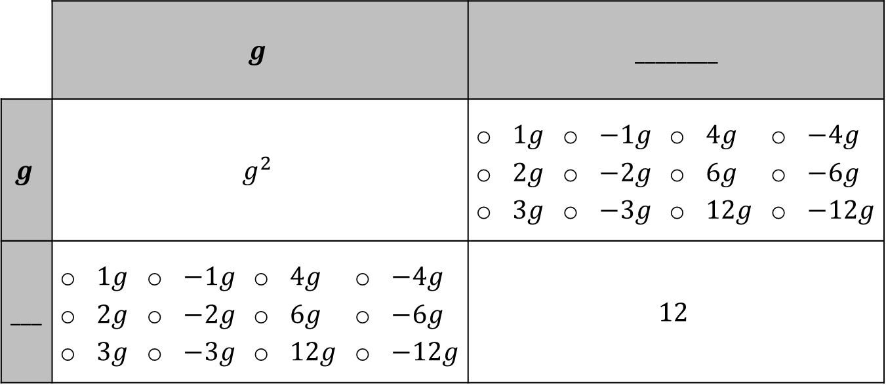
Complete the table for $g^{2}+8g+12$.
 | $$g$$ |  |  |  | ________
$$g$$ | $$g^{2}$$ |  |  |  | $1g$ $2g$ $3g$ | $−1g$ $−2g$ $−3g$ | $4g$ $6g$ $12g$ | $−4g$ $−6g$ $−12g$
___ | $1g$ $2g$ $3g$ | $−1g$ $−2g$ $−3g$ | $4g$ $6g$ $12g$ | $−4g$ $−6g$ $−12g$ | $$12$$
volume 1, pg. 371

Slide 11

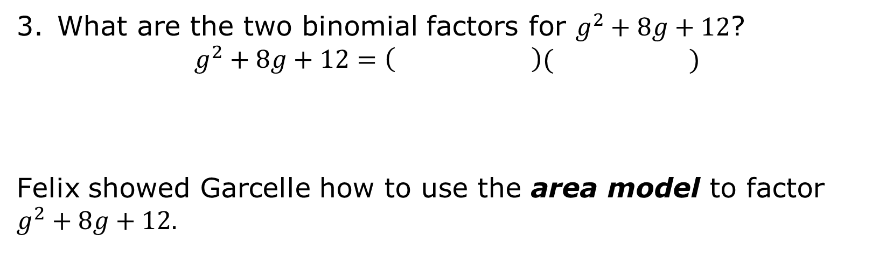
What are the two binomial factors for $g^{2}+8g+12$?
$$g^{2}+8g+12=\left( \right)( )$$
Felix showed Garcelle how to use the area model to factor $g^{2}+8g+12.$
The area model is a rectangular diagram that utilizes the decomposition of side lengths by place value to multiply numbers using the distributive property.
volume 1, pg. 371

Slide 12
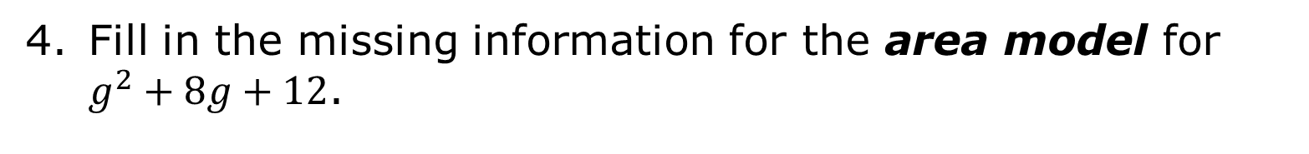
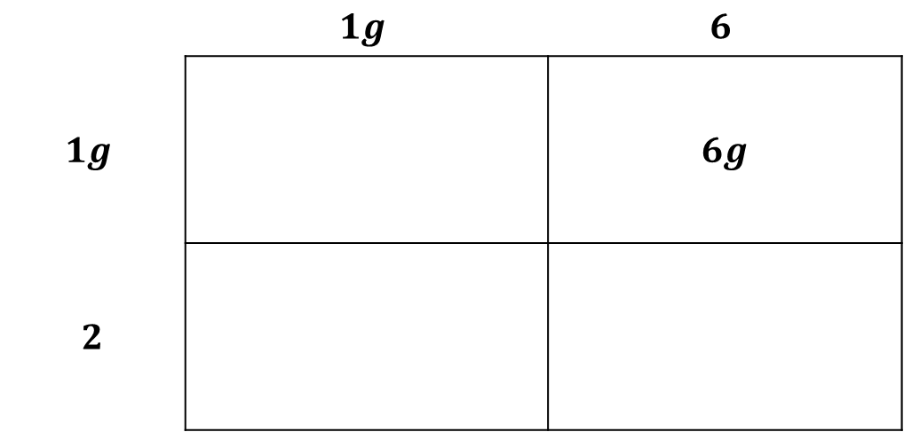
Fill in the missing information for the area model for $g^{2}+8g+12$.
 | $$1g$$ | $$6$$
$$1g$$ |  | $$6g$$
$$2$$
volume 1, pg. 371

Slide 13
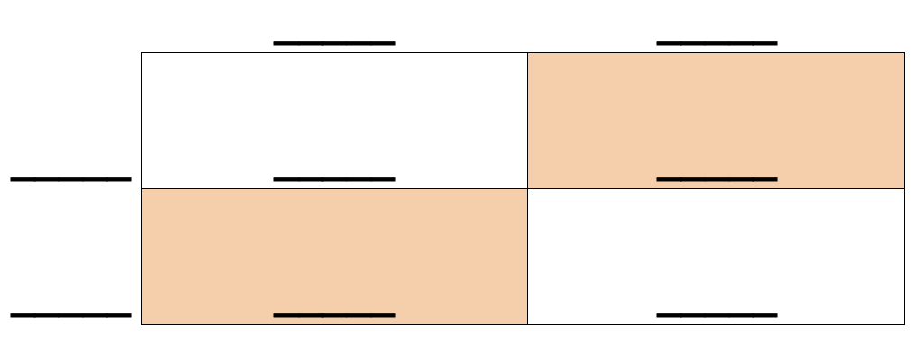
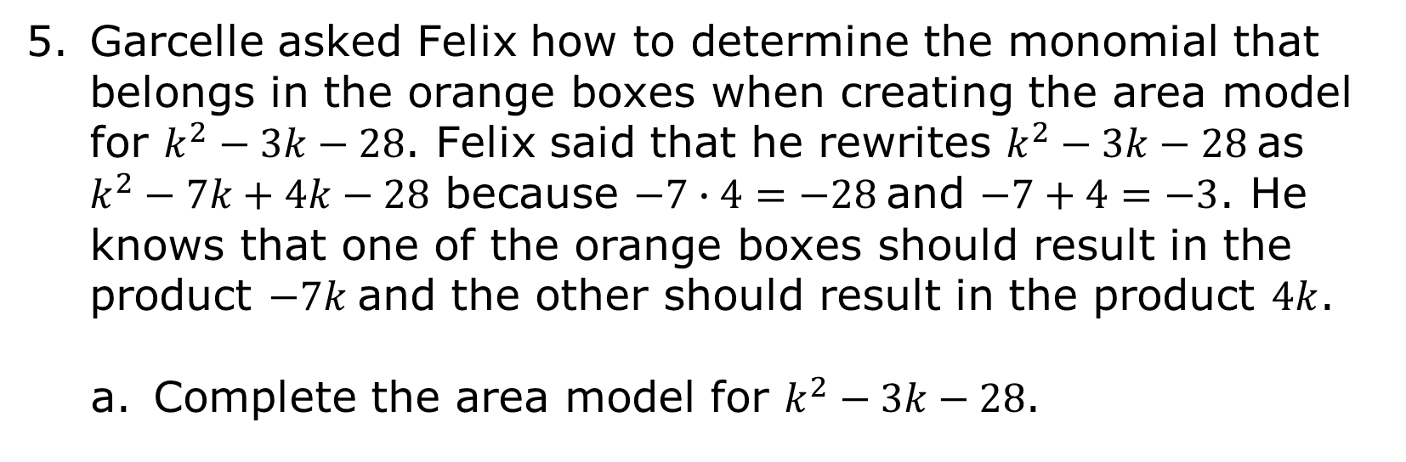
Garcelle asked Felix how to determine the monomial that belongs in the orange boxes when creating the area model for $k^{2}−3k−28$. Felix said that he rewrites $k^{2}−3k−28$ as $k^{2}−7k+4k−28$ because $−7∙4=−28$ and $−7+4=−3$. He knows that one of the orange boxes should result in the product $−7k$ and the other should result in the product $4k$.
Complete the area model for $k^{2}−3k−28$.
volume 1, pg. 371

Slide 14
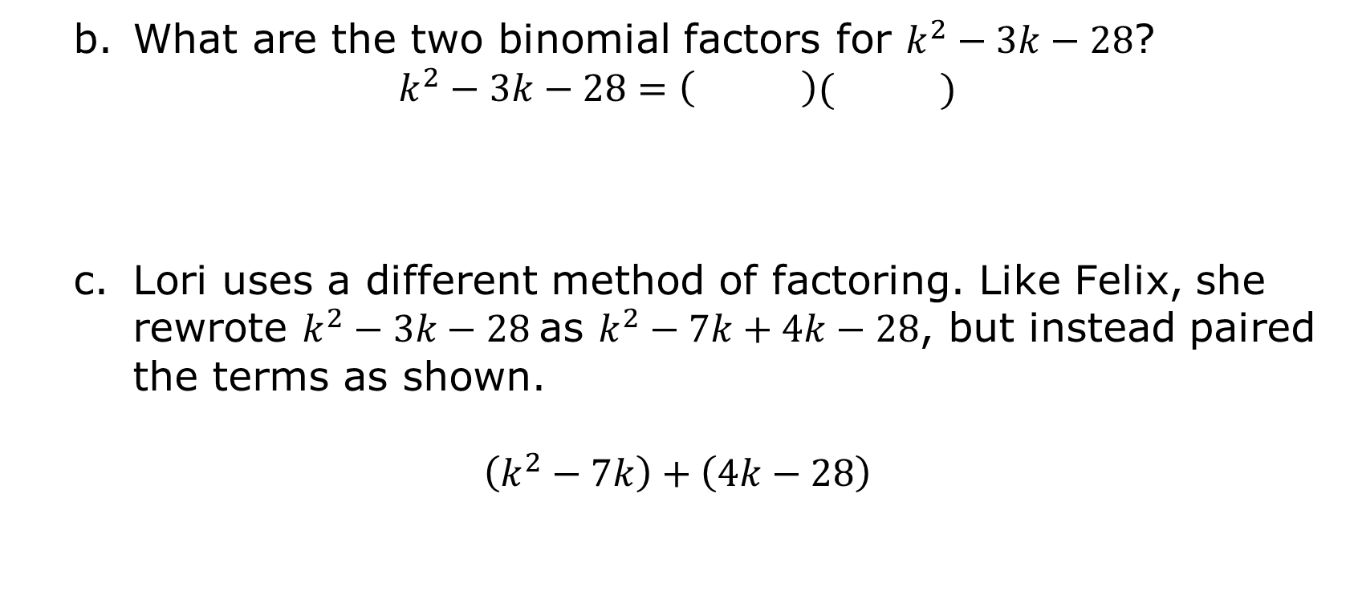
What are the two binomial factors for $k^{2}−3k−28$?
$$k^{2}−3k−28=\left( \right)( )$$
Lori uses a different method of factoring. Like Felix, she rewrote $k^{2}−3k−28$ as $k^{2}−7k+4k−28$, but instead paired the terms as shown.
$$\left(k^{2}−7k\right)+\left(4k−28\right)$$
volume 1, pg. 372

Slide 15
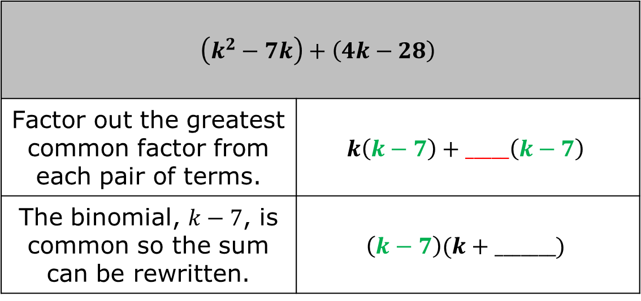
Work with your partner to finish factoring using Lori’s method, known as factoring by grouping, using the following steps.
$$\left(k^{2}−7k\right)+\left(4k−28\right)$$
Factor out the greatest common factor from each pair of terms. | $$k\left(k−7\right)+_____\left(k−7\right)$$
The binomial, $k−7$, is common so the sum can be rewritten. | $$\left(k−7\right)(k+_______)$$
volume 1, pg. 372

Slide 16
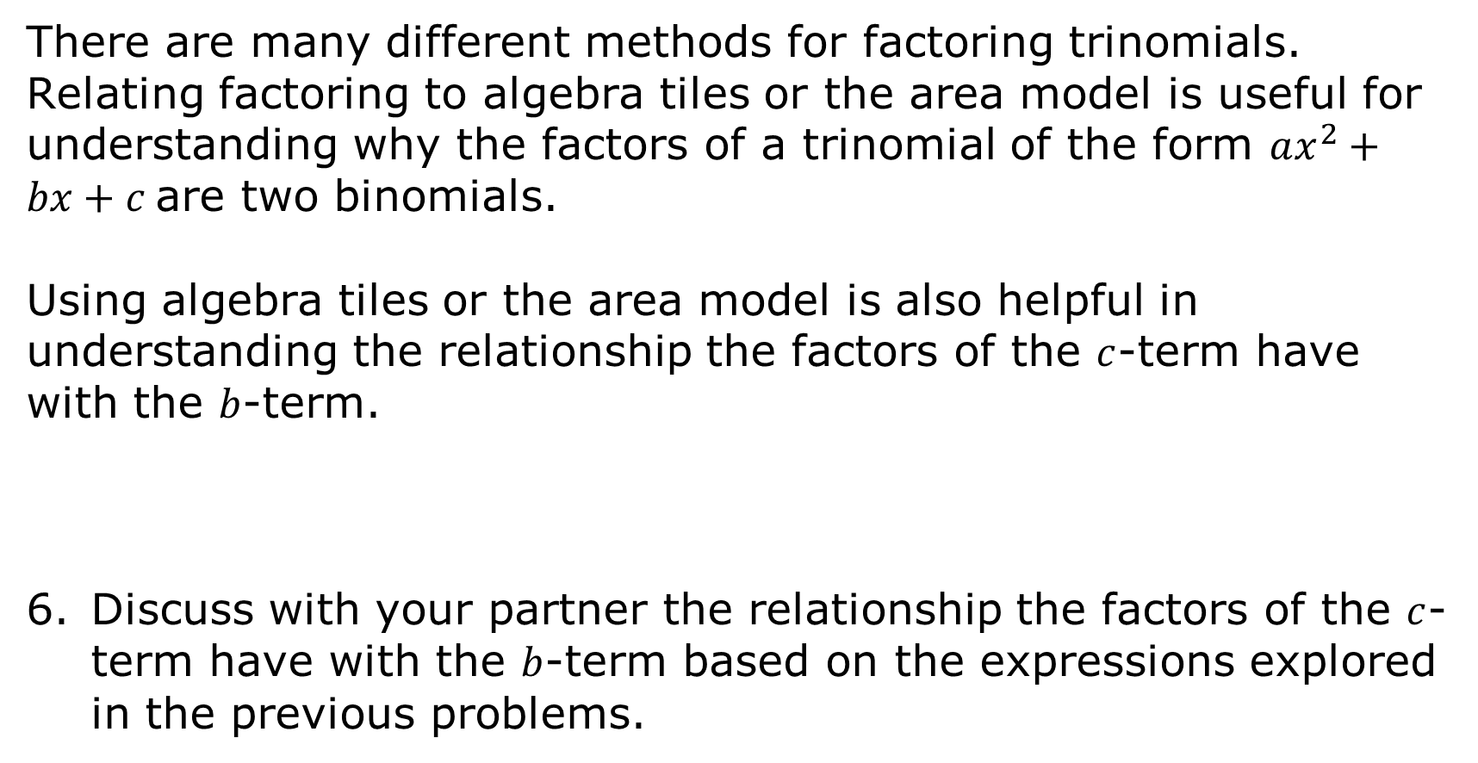
There are many different methods for factoring trinomials. Relating factoring to algebra tiles or the area model is useful for understanding why the factors of a trinomial of the form $ax^{2}+bx+c$ are two binomials.
Using algebra tiles or the area model is also helpful in understanding the relationship the factors of the $c$-term have with the $b$-term.
Discuss with your partner the relationship the factors of the $c$-term have with the $b$-term based on the expressions explored in the previous problems.
volume 1, pg. 372

Slide 17

Guided Instruction
volume 1, pg. 373

Slide 18

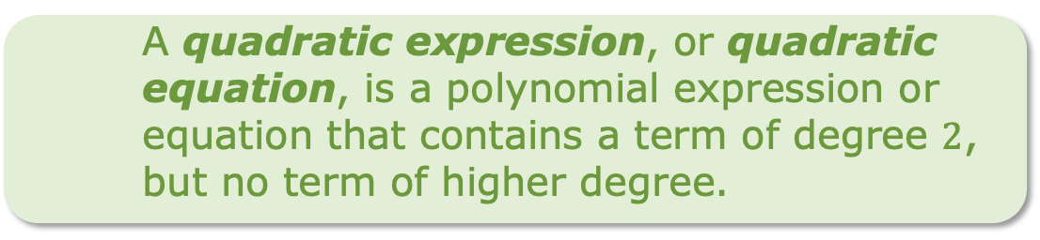
7.3.3 Guided Instruction: Factoring Trinomials Where a = 1
Factoring quadratic expressions in the form of trinomials such as ${ax}^{2}+bx+c$, where $a=1$, results in the factors $\left(x+g\right)\left(x+h\right)$ where, $g∙h=c$ and $g+h=b$. Later in this unit, factoring trinomials where $a$ is a value other than $1$ will be explored.
A quadratic expression, or quadratic equation, is a polynomial expression or equation that contains a term of degree $2$, but no term of higher degree.
volume 1, pg. 373

Slide 19

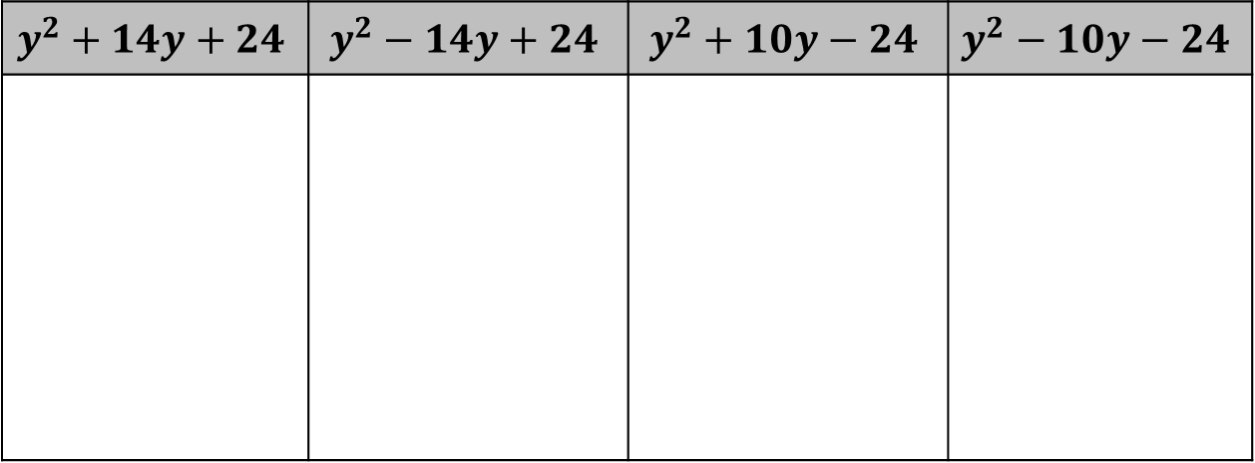
Consider the trinomials $y^{2}+14y+24$, $y^{2}−14y+24$,
$y^{2}+10y−24$, and $y^{2}−10y−24$.
Factor each trinomial.
Describe any similarities between the four trinomials.
$$y^{2}+14y+24$$ | $$y^{2}−14y+24$$ | $$y^{2}+10y−24$$ | $$y^{2}−10y−24$$
volume 1, pg. 373

Slide 20
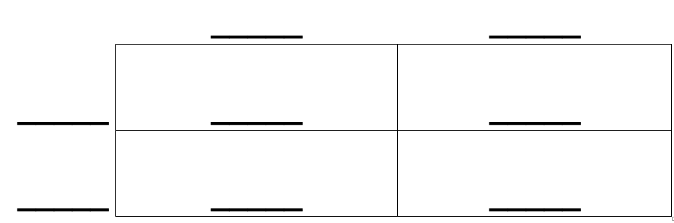
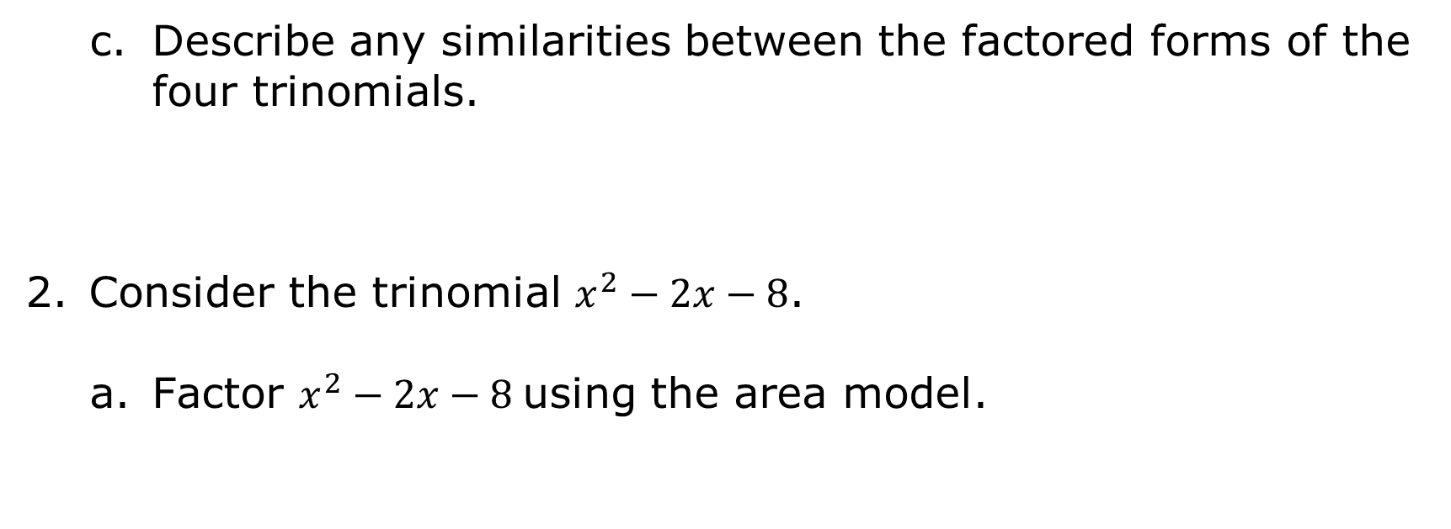
Describe any similarities between the factored forms of the four trinomials.
Consider the trinomial $x^{2}−2x−8$.
Factor $x^{2}−2x−8$ using the area model.
volume 1, pg. 373

Slide 21
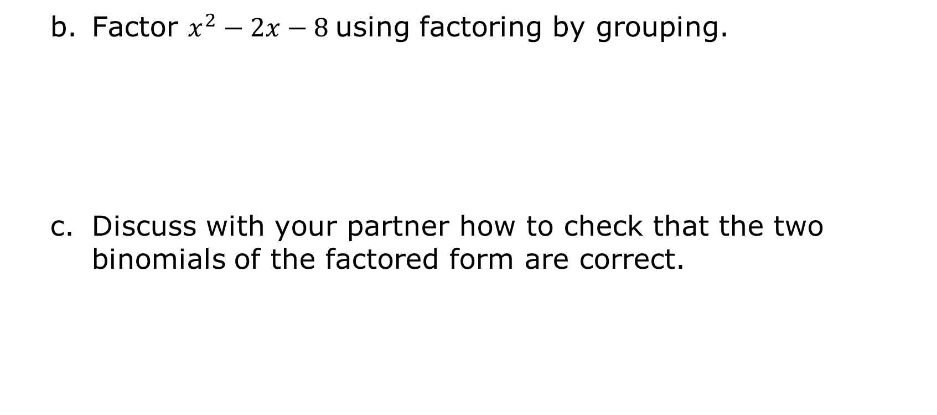
Factor $x^{2}−2x−8$ using factoring by grouping.
Discuss with your partner how to check that the two binomials of the factored form are correct.
volume 1, pg. 373

Slide 22

Your Turn
volume 1, pg. 374

Slide 23

7.3.4 Your Turn!
Factor each quadratic expression using the method of your choice.
$d^{2}+11d+24$
$a^{2}−9a+14$
$+4x−96$
volume 1, pg. 374

Slide 24

Wrap-Up
volume 1, pg. 374

Slide 25
7.3.5 Wrap-Up: Cool Down
Write a short note to a friend who missed class summarizing today’s lesson. Include something you learned and a mistake you learned from.
volume 1, pg. 374

